Slide 1
Section 7.3 Chord Properties
© Copyright all rights reserved to Homework depot: www.BCMath.ca

Slide 2
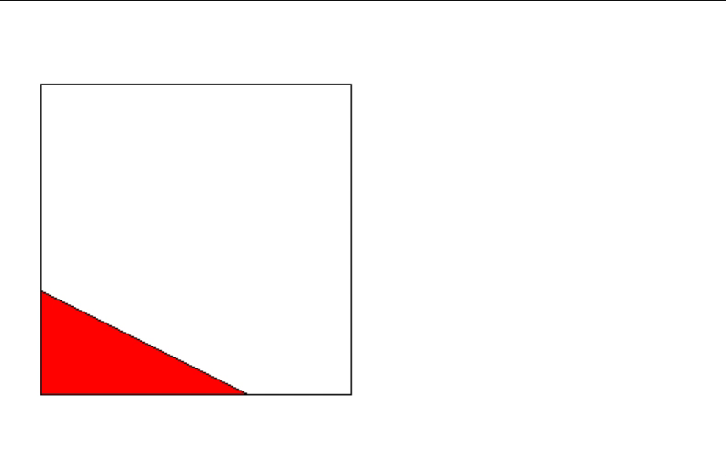
i) Review
A chord is a line with both endpoints on the circumference
Pythagorean Theorem:
  Right Triangles
Ex: Given each triangle, find the length of the missing side:

Slide 3
Pythagorean Triples
  A group of 3 integers that satisfy the Pythagorean formula
  Ie: (3 ,4, 5) (5, 12, 13) ….
  Multiples of Pythagorean Triples are also P.T.
Base Pyth. Triples can be generated with the hypotenuse and one side as consecutive numbers
For any values of “x” that make this expression a perfect square, a Pythagorean triple can be created

Slide 4
II) Chord Properties:
There are 3 main chord properties: If any two is true, the third one must also be true
A) A line bisects a chord
B) A line is perpendicular
to a chord
C) A line passes through the
“center of the circle” and
the chord

Slide 5
If A & B are true → Then C must be true
If a Line bisects and perpendicular to a chord,
then it must cross the center of the circle
If B & C are true → Then A must be true
If a Line through the center of the circle is perpendicular to the chord ,
then it must bisects the chord
If A & C are true → Then B must be true
If a Line through the center of the circle
bisects the chord ,
then it must be perpendicular to the chord

Slide 6
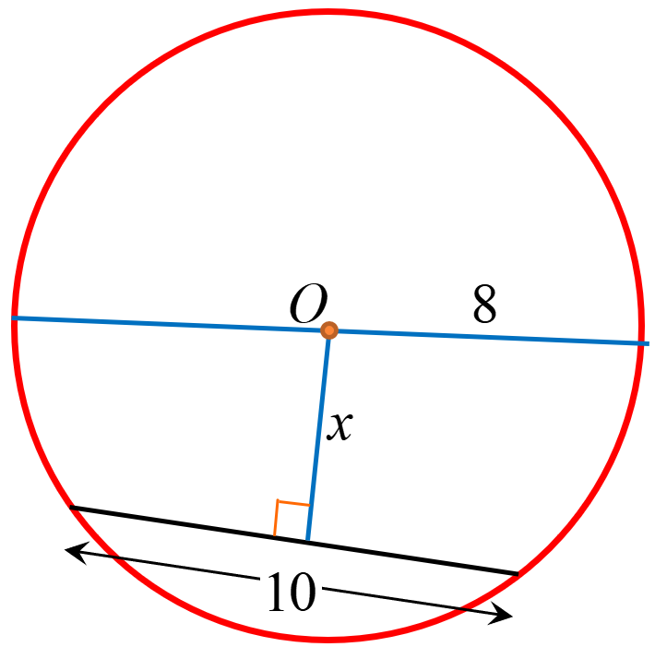
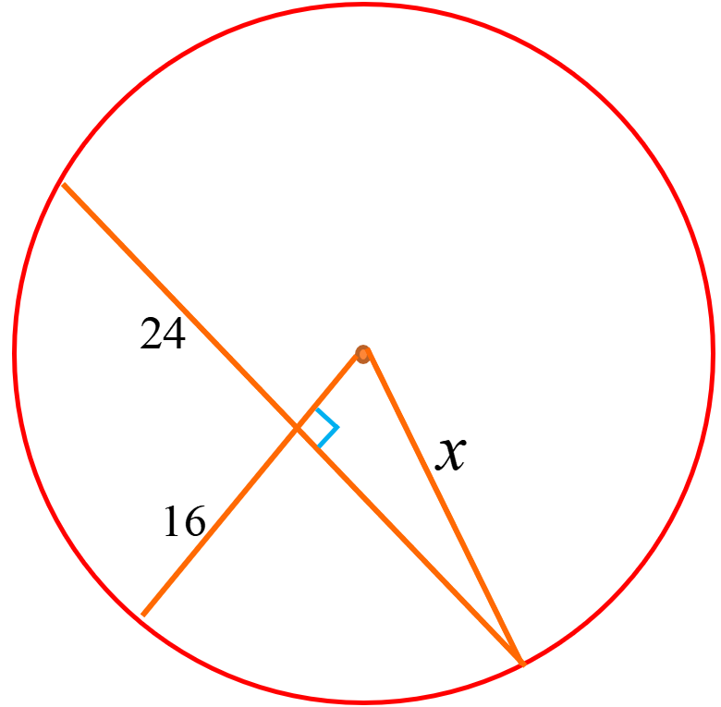
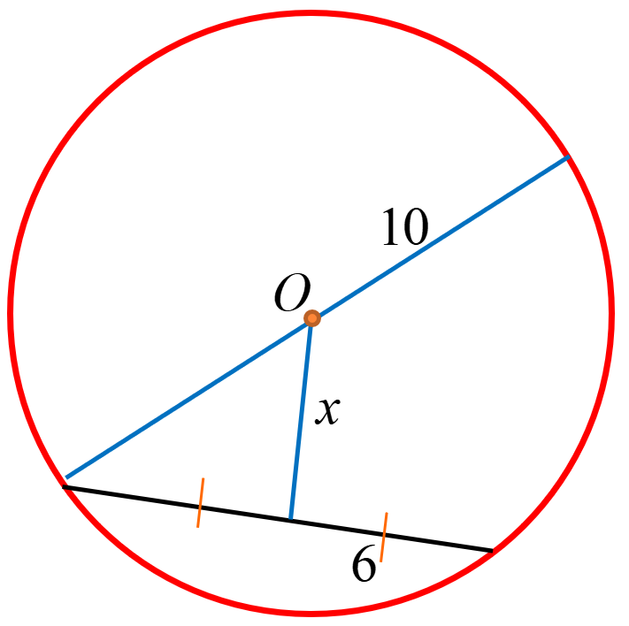
Ex: Find the missing side “x”

Slide 7
Ex: Find the missing side “x”
All radii’s in a circle are equal
The chord is bisected, so both sides
must be equal
Since the line through the center is
bisecting the chord, it must cross at
90°
Right Triangle → Pythagorus

Slide 8
Practice: Find the missing side “x”
Since the line through the center is
perpendicular to the chord,
it must bisect it.
All radii’s in a circle are equal
Add another radii to create a right
Triangle

Slide 9
Practice: Find length of the missing side “x”
The Chord is bisected, so the other
side is also 24
The Radius is “x”, so the remaining
Side of the triangle is “x – 16”
Use Pythagorus to find the value of
“x”
Pythagorean Triple!!

Slide 10
III) Review: Perpendicular Bisector Theorem
The perpendicular bisector of any chord will contain the center of the circle

Slide 11

IV) Carpenters Method
How to Find the center of a Circle
Draw two chords
Draw the Perpendicular bisector of each chord
The Perpendicular bisectors will cross at the center of the circle
The perpendicular bisectors
of any two chords in a circle
will always intersect at the
center of the circle

Slide 12
V) Two Chords Theorem
If two chords have the same length, then they will be equal distances from the center
In contrast, if the distance from the center were the same, the chords will be equal in length

Slide 13
Ex: Find the length of the missing side “x”

Slide 14
Ex: Without using the 2 chord thm., Prove AB=CD
Given:
Statement | Reason

Slide 16
In the diagram, AD, BC, CD, and DE are all equal in length. IF CE is tangent to the circle, then which of the following statement below are correct?
A
B
D
I) CA = CE
C
II) BD is parallel to CE
E
III) AD = DE
IV) AC = BD

Slide 17
In the diagram, the ratio of
arcBEC : arcCFD : arcDGA
are in the ratio of 2:3:4.
If Angle AID is 54 degrees,
what is the ratio of
arcaAHB : Circumference?
H
B
E
C
I
F
A
G
D

